Slide 1
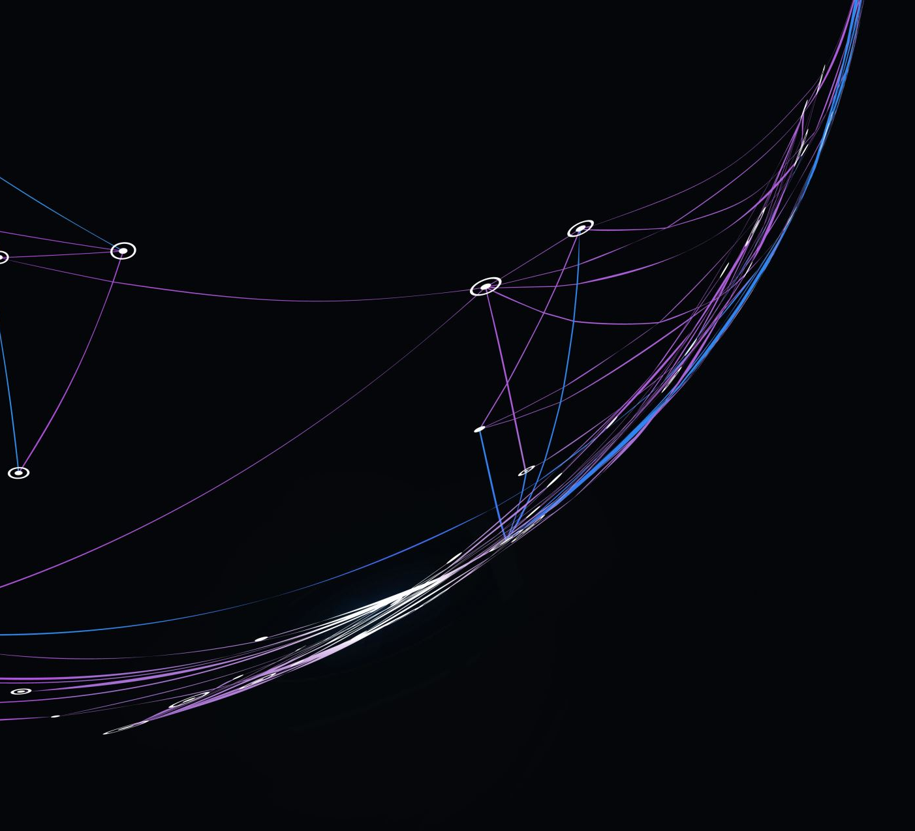
Build my life
CCLI: CCLI: Brett Younker, Karl Martin, Kirby Kaple, Matt Redman, Pat Barrett
© 2016 Martin, Karl Andrew (Admin. by Sentric Music)
Bethel Music Publishing (Admin. by SHOUT! Music Publishing Australia)
Capitol CMG Genesis (Admin. by SHOUT! Music Publishing Australia)
Housefires Sounds (Admin. by SHOUT! Music Publishing Australia)
Kaple Music (Admin. by SHOUT! Music Publishing Australia)
Said And Done Music (Admin. by SHOUT! Music Publishing Australia)
sixsteps Music (Admin. by SHOUT! Music Publishing Australia)
Thankyou Music (Admin. by SHOUT! Music Publishing Australia)
Vamos Publishing (Admin. by SHOUT! Music Publishing Australia)
worshiptogether.com songs (Admin. by SHOUT! Music Publishing Australia)
CCLI Licence No. 5485849
7070345

Slide 2
Verse 1
Worthy of every song we could ever sing
Worthy of all the praise we could ever bring

Slide 3
Verse 1
Worthy of every breath we could ever breathe
We live for You
Oh, we live for You

Slide 4
Verse 2
Jesus, the Name above every other name
Jesus, the only One who could ever save

Slide 5
Verse 2
Worthy of every breath we could ever breathe
We live for You
We live for You

Slide 6
Chorus
Holy, there is no one like You, there is none beside You
Open up my eyes in wonder and

Slide 7
Chorus
Show me who You are and fill me with Your heart
And lead me in Your love to those around me

Slide 8
Verse 3
Jesus, the name above every other name
Jesus, the only One who could ever save

Slide 9
Verse 3
You're worthy of every breath we could ever breathe
We live for You
Oh we live for You

Slide 10
Chorus
Holy, there is no one like You, there is none beside You
Open up my eyes in wonder and

Slide 11
Chorus
Show me who You are and fill me with Your heart
And lead me in Your love to those around me

Slide 12
Bridge
And I will build my life upon Your love, it is a firm foundation
And I will put my trust in You alone and I will not be shaken
(x2)

Slide 13
Chorus
Holy, there is no one like You, there is none beside You
Open up my eyes in wonder and

Slide 14
Chorus
Show me who You are and fill me with Your heart
And lead me in Your love to those around me

